Slide 1
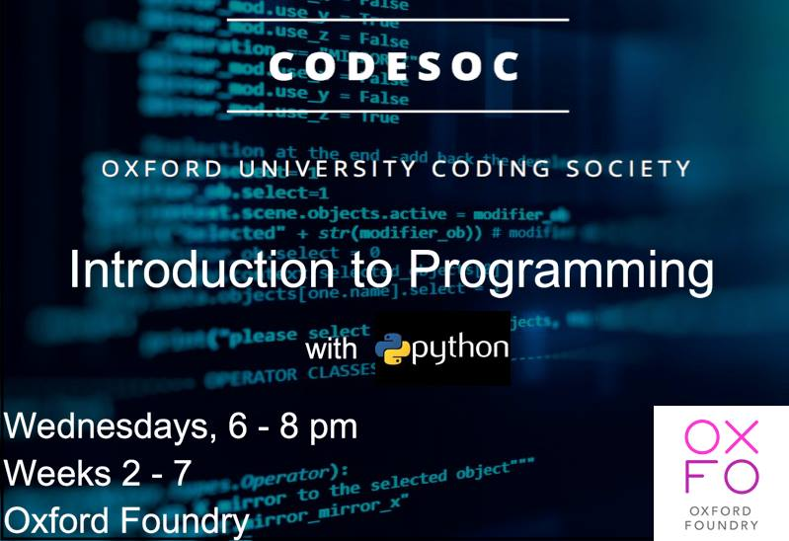

Slide 2
Overview:
Quiz : https://oxfordsaid.eu.qualtrics.com/jfe/form/SV_4ZNhFyZbaShWdcp
Review Functions : “Exercises”
Classes and Object Orientation
Alarms
Emails
Notes:
[Go through Quiz] Quiz URL is also in Exercises.ipynb
Go through functions “Exercises”]

Slide 3

Class
Notes:
What is a class?

Slide 4
Class
- Abstract idea
Notes:
It’s an abstract idea in computer science.

Slide 5
Class
1.) An object-creator.
Notes:
The simplest definition of a class, is that it’s an object creator

Slide 6
Class
1.) An object-creator.
What is an object?
Notes:
A natural follow-up question is, what is an object?

Slide 7
Objects
A collection of attributes and methods

Slide 8
Objects
A collection of attributes and methods
variables
functions

Slide 9
Objects
Attributes can be viewed as specifying the state of the object
Methods can be viewed as actions that act on the state of the object.

Slide 10
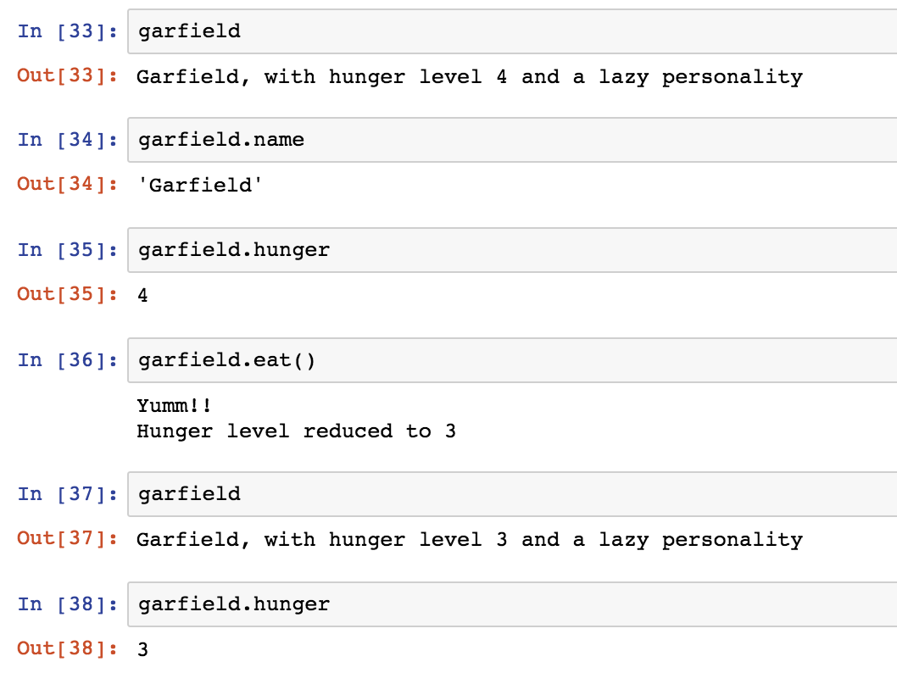
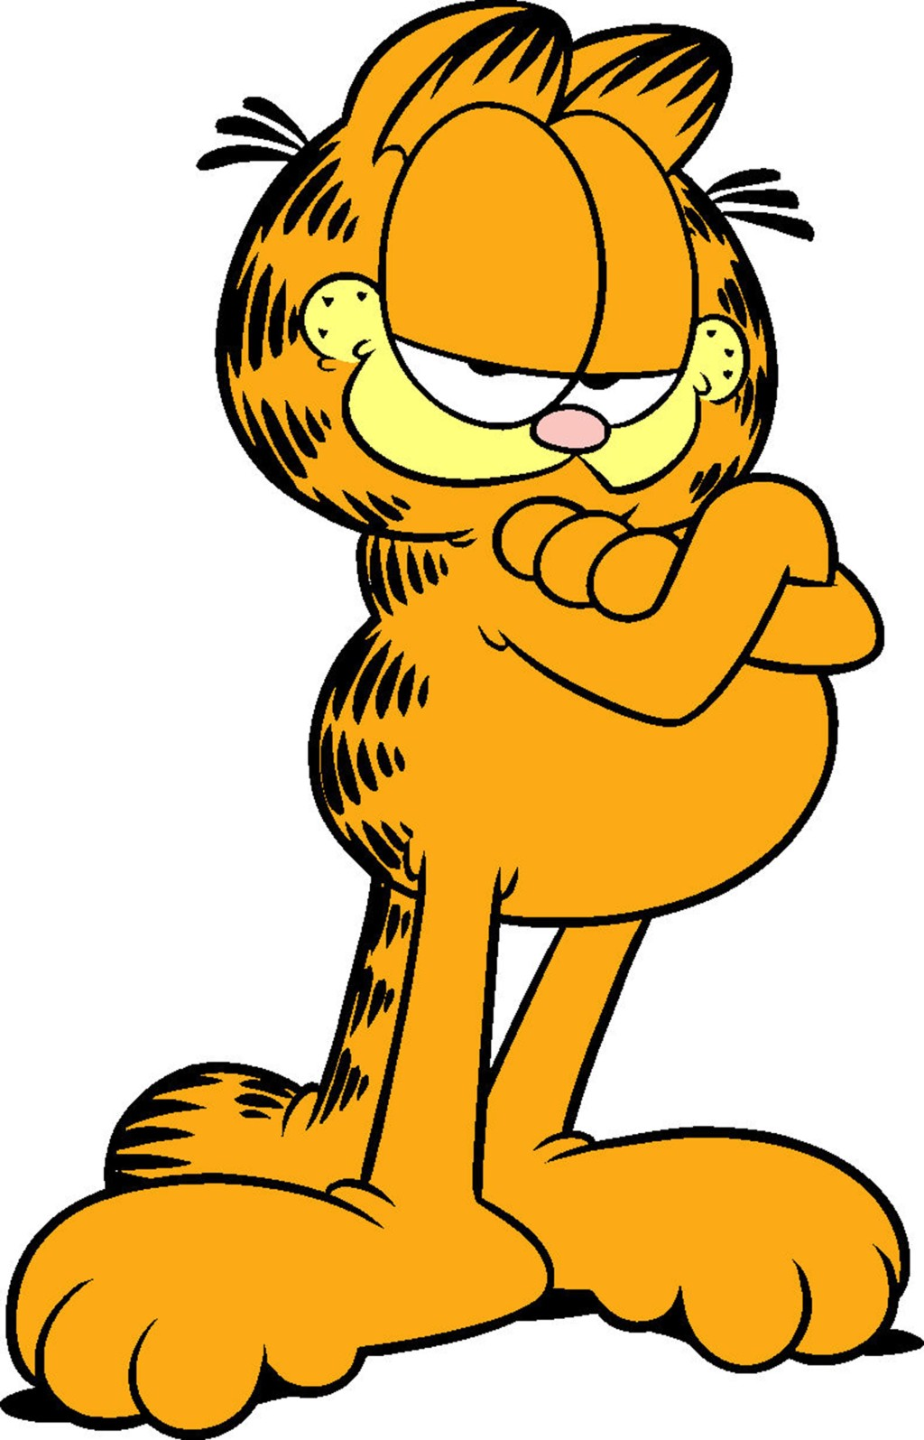
Objects: An example
Notes:
So you can imagine making a garfield object in Python to model Garfield the cat.

Slide 11
Objects: An example
Notes:
Here we see that he has two attributes: his name and his hunger level

Slide 12
Objects: An example
Notes:
And he also has a method called “eat”

Slide 13
Objects: An example
Notes:
And by giving Garfield and his hunger a second look we realize that eating has indeed reduced his hunger level.

Slide 14
Object
contains
contains
Attributes
Methods

Slide 15
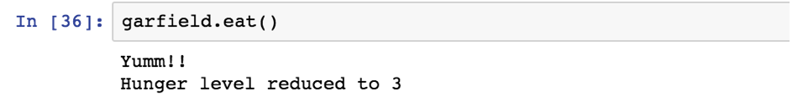
Object
contains
contains
Attributes
Methods
can act on

Slide 16
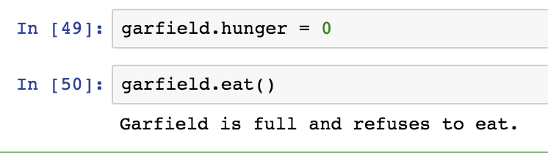
Object
contains
contains
Attributes
Can influence
Methods
can act on
Notes:
It’s all inter-connected.

Slide 17
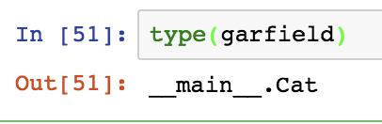
What happens if?
Notes:
Python does not have a built-in cat type, so I made my own!

Slide 18
What happens if?
Class!
Notes:
Python does not have a built-in cat type, so I made my own!

Slide 19
What happens if?
Class!
Notes:
Python does not have a built-in cat type, so I made my own!

Slide 20
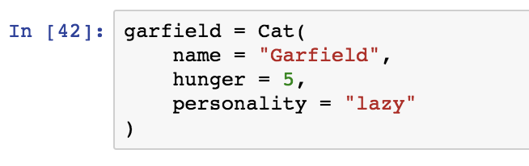

What is Cat?
Cat() is a Class. Cat() is an object-creator.
Notes:
Python does not have a built-in cat type, so I made my own!

Slide 21
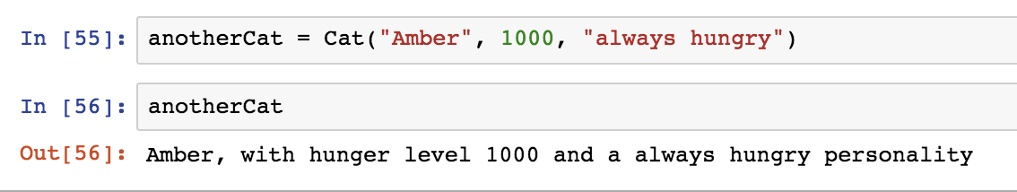
I can make any cat!
Notes:
Python does not have a built-in cat type, so I made my own!

Slide 22
Class
1.) An object-creator.
2.
Notes:
So recall our previous definiton:

Slide 23
Class
1.) An object-creator.
2. A Template for creating a specific type of object
Notes:
We can actually expand on this

Slide 24
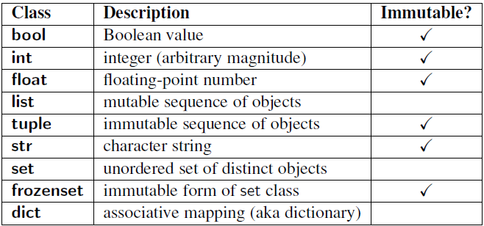
Notes:
A natural follow-up question is, what is an object?

Slide 25

Why do we care?
Notes:
So why do we care?

Slide 26

Who hates debugging?

Slide 27

We want organized code

Slide 28
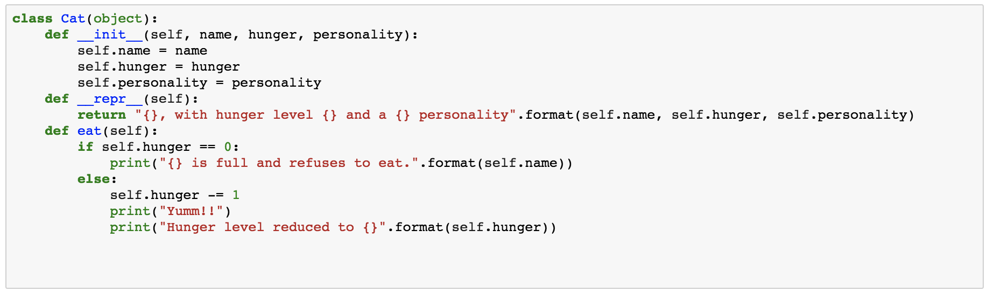
What does a class look like?

Slide 29
What does a class look like?

Slide 30
What does a class look like?

Slide 31
What does a class look like?

Slide 32
What does a class look like?
Notes:
Here’s the important stuff: All of the methods and attributes attached to the cat class are inside the class.

Slide 33
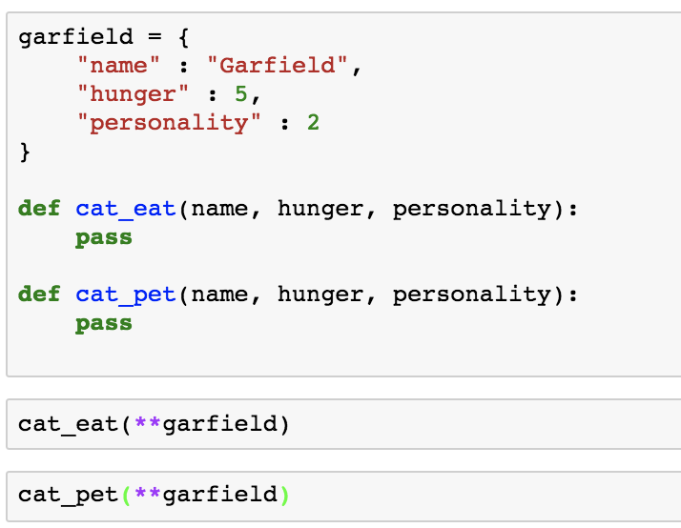
The Alternative?
Notes:
Say we didn’t have classes, what would we do? Well, we could use a dictionary to keep the variables associated with the cat together… And then we would have a bunch of functions…

Slide 34
The Alternative?
Notes:
We’ll probably cat in the name, to distinguish it from “dog eat”, “human eat”, etc.

Slide 35
The Alternative?
Notes:
And If I’m always passing all these inputs into the function, shouldn’t I just make the input implicit?

Slide 36
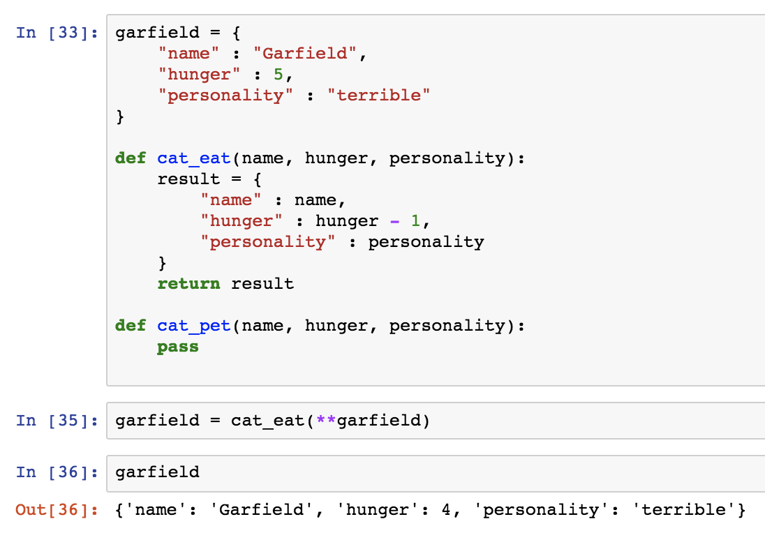
The Alternative?
Notes:
And I can’t really change the dictionary values in the function. I have to make a new dictionary, return that one and overwrite the old one.
It’s a little bit awkward to have to rebuild the whole cat every single time I want to change something in a function.

Slide 37
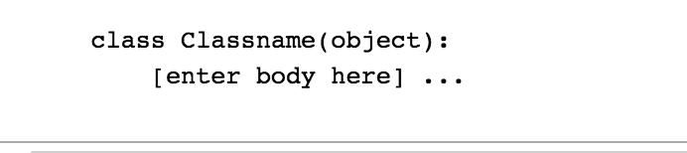
Notes:
So let’s return to the class and try to understand what this is saying here.

Slide 38
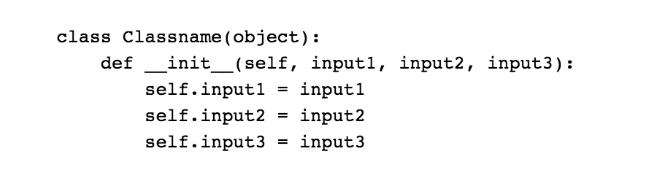
Notes:
What does the double underscore mean?

Slide 39
What does “__” mean?
Dunder function
Magic method

Slide 40
__init__(self)
“Constructor”
It makes the object
“self” refers to the object
Notes:
https://docs.python.org/3/reference/datamodel.html

Slide 41
Notes:
Explain what is happening line-by-line.

Slide 42
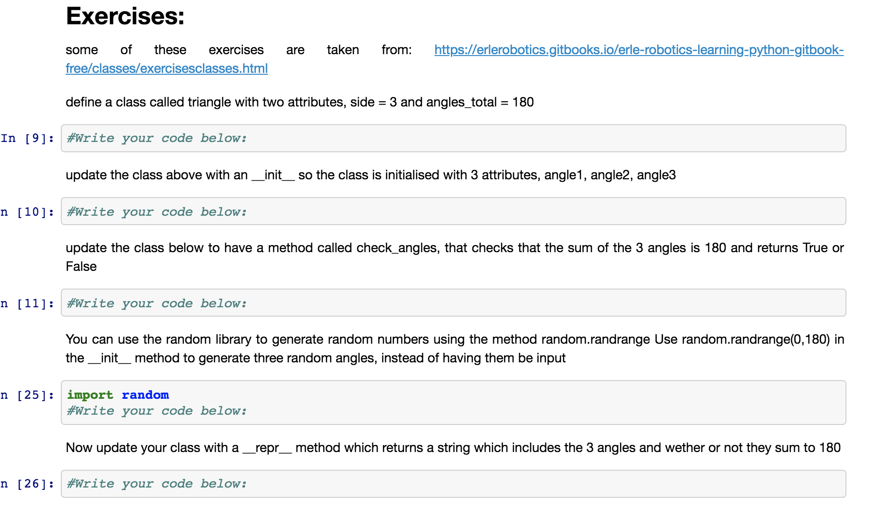
Notes:
Work down the “Classes” notebook until you hit this point. Explain encapsulation with TV remote analogy.

Slide 43
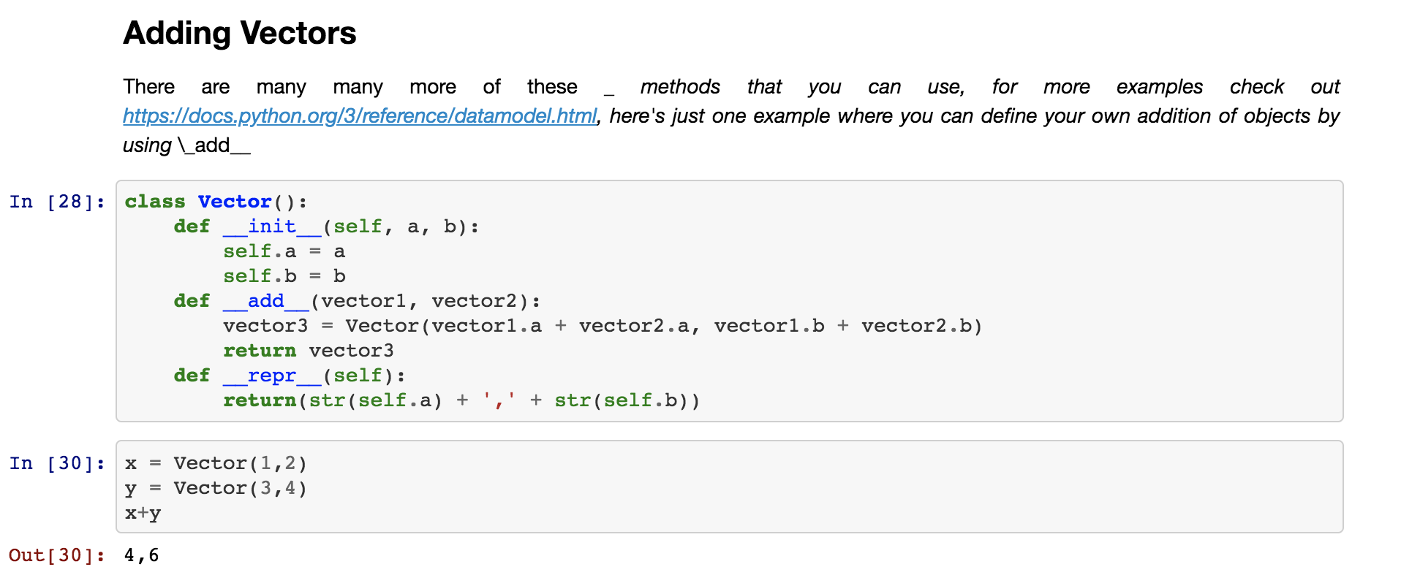
Notes:
If you’re feeling adventurous, try making a Vector class for vectors of different sizes.
Compare Results in numpy. Talk about how we get to use lower level languages (sorta)

Slide 44
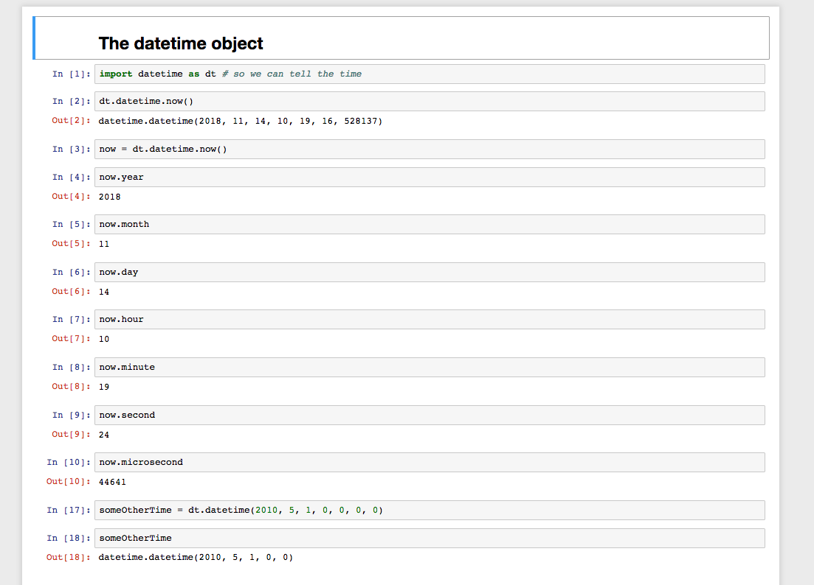
Notes:
And let’s try to work through Alarms

Slide 45
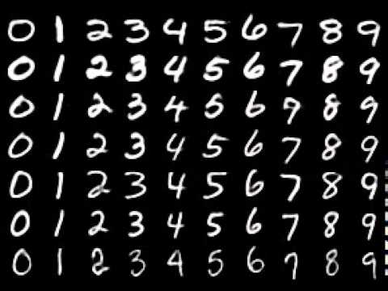
Notes:
And let’s try to work through Alarms

